Slide 1


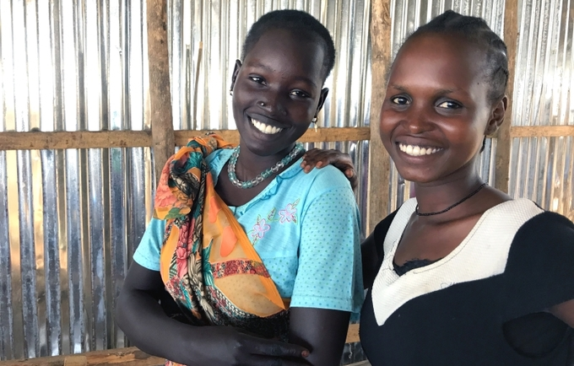
2021 UN COUNTRY ANNUAL RESULTS REPORT
SOUTH SUDAN
MAY 2022
INSERT IMAGE HERE

Slide 2

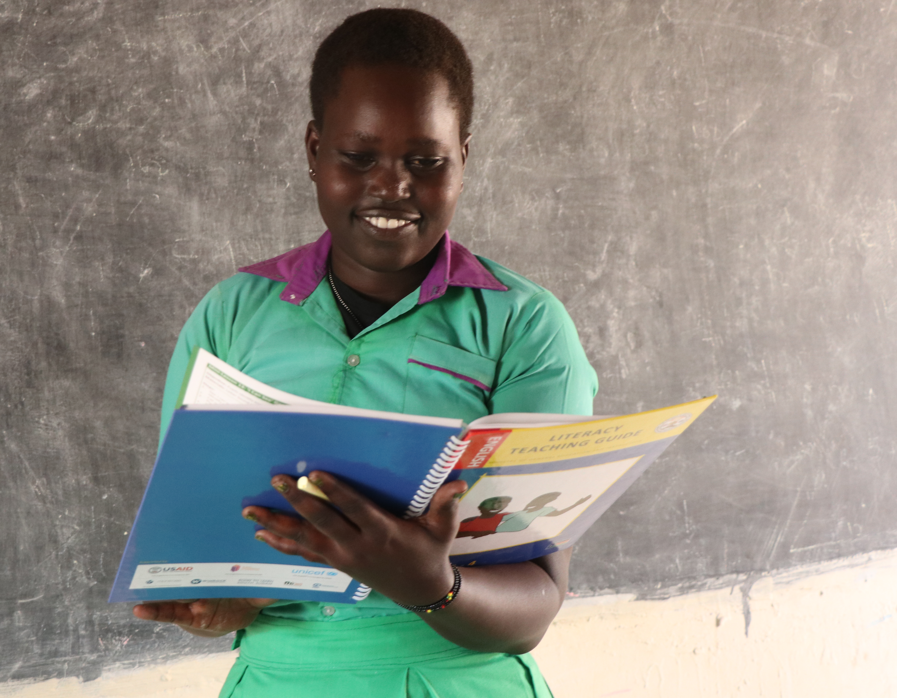
2021 UN COUNTRY ANNUAL RESULTS REPORT
SOUTH SUDAN
May 2022
INSERE IMAGE HERE

Slide 3
Table of Contents
Foreword by the Resident Coordinator | 4
UN Country Team | 5
Chapter I: Context Developments | 6
Chapter 2: UN Development System Support to National Priorities through the Cooperation Framework | 8
2.1. Overview of UNCF Results | 8
2.2. Priorities Under the UNCF: Key Results Secured with UN Support | 11
2.3. Support to Partnerships and Financing the 2030 Agenda | 21
2.4. Results of the UN Working More And Better Together: UN Coherence, Effectiveness and Efficiency | 22
2.5. Evaluations and Lessons Learned | 22
2.6. Financial Overview and Resource Mobilization | 23
Chapter 3: UNCT Key Focus for 2022 | 24

Slide 4
Foreword by the Resident Coordinator
I am pleased to present the 2021 UN Cooperation Framework (UNCF) annual report for South Sudan. It is the third of such reports under the current Framework. Against the backdrop of significant humanitarian challenges, driven by climate change induced disasters and an upsurge in localised conflicts, the UN Country Team (UNCT) has nonetheless increased the delivery rate to 91%, with expenditure amounting to USD 264,359,599 in 2021. This represents a 30% improvement on the previous year’s performance.
Throughout the year, the UNCT has enjoyed high-level dialogue with the government on a number of key humanitarian, peace and sustainable development concerns. For example, the National Food Systems Dialogues were used to inform global discussions at the UN’s General Assembly and the UNCT provided financial and technical support for the development of a National Youth Strategy currently at the legislature. The Strategy will support the protection and promotion of the human rights of every young person, empowering each to build their resilience, achieve their potential and make positive contributions as agents of change in South Sudan.
Other key achievements worthy of mention include the mobilisation of USD 11.7 million from the UN’s Peacebuilding Support Office for three key initiatives related to provisions under the Revised-Agreement on the Resolution of the Conflict in South Sudan (R-ARCSS): the drafting of the permanent constitution, community action for peaceful resolution; and transitional Justice. A Peacebuilding Fund Secretariat has been established in the RCO to provide coordination and oversight of the projects. Further, the UNCT facilitated the set-up of the Truth, Healing and Reconciliation Forum, the establishment of governance administration across the 10 States and 3 administrative areas and organisation of the fifth Governance forum. The latter identified 20 key actions including addressing floods, mitigating the effects of climate change and expediting the training, graduation and deployment of a unified force. Regarding Gender and Women’s Empowerment (GEWE) several initiatives are at advanced stage with the UN’s support, including the drafting of policy documents for a Women’s Development Fund, the Anti-GBV Bill signalling an end to impunity for SGBV perpetrators, plus the Strategic National Action Plan on Elimination of Child Marriage. The UNCT has also provided technical support to the government for the review of the National Development Strategy (R-NDS), conduct of fragility assessments and formulation of State Plans. These will
inform medium to long-term development priorities and help to reinvigorate the aid architecture in South Sudan. Assistance from the UN has also enabled the Government to make progress on Public Finance Management (PFM) reforms building trust and yielding direct benefits. The World Bank has availed a USD 34 million grant to Government to advance PFM reforms, strengthen key oversight institutions, improve budget transparency and related outcomes in the country.
As part of the operationalization of Humanitarian-Development-Peace (H-D-P) Nexus, or what I have coined for South Sudan as the PHD, noting that peace is a requirement for moving forward on H and D, the UNCT remains committed to joint analysis and strategic planning across the three domains. The creation of the Common Country Analysis was inclusive, participatory and consultative, involving actors from across all three sectors. Relatedly, the UNCT and Humanitarian Coordination Team (HCT) has agreed with the UN Mission on three collective outcomes for 2022 to build synergies and interlinkages: food security; gender -based violence; protection. Under the forthcoming UN Sustainable Development Cooperation Framework (UNSDCF) 2023-2025, further efforts are underway to strengthen collaboration across the H-D-P nexus both within the UN family and with partners, including the creation of collective results and joint programmes. This will support the shift away from reliance on humanitarian assistance and towards sustainable development and long-term peace, expressed as a key goal under the R-NDS.
Finally, regarding the UN’s operational efficiencies, the UNCT is implementing the Business Operations Strategy 2.0. This encompasses common services in human resources, administration and logistics, procurement, ICT and finance. For the first time, the UNCT has been able to monitor and report on cost avoidance and quality improvement due to collaboration on agreed common services. Costs avoidance amounting to US$8.18 million has been recorded for the period 2019-2021 against a projection of US$ 15.95 million for 2019-2024 period; and the quality of those services have shown modest improvement. This is enabling more resources to be allocated to meet the short, medium and long-term needs and aspirations of the people of South Sudan.
Sara Beysolow Nyanti
Deputy Special Representative of the Secretary General, Resident Coordinator and Humanitarian Coordinator

Slide 5

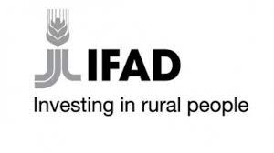
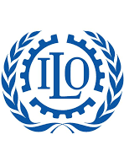













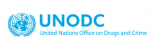




UN Country Team
Agencies Under the Cooperation Framework
The UNCT in South Sudan is comprised of a number of UN entities operating across the humanitarian, development and peace nexus.
Whilst the Humanitarian Response Plan is coordinated by OCHA, interventions in the sub-sector are linked to the UNCF through two collective Outcomes around Food Security and Gender-Based Violence. Likewise, the UN Mission for South Sudan contributes to UNCF priorities related to peacebuilding and governance. The World Bank and African Development Bank also participate in meetings of the UN Country Team, further facilitating joined-up, whole-of-system programming to address South Sudan’s complex range of challenges.
Agencies contributing directly to the UNCF are as follows: FAO; IFAD (non-resident); ILO (non-resident); IOM; UN Women; UNAIDS; UNDP; UNEP (non-resident); UNESCO; UNFPA; UN-HABITAT (non-resident); UNHCR; UNICEF; UNIDO (non-resident); UNMAS; UNODC (non-resident); UNOPS; WFP; WHO.
ILO and IFAD rejoined the country team in 2021, bringing much-needed expertise to two of the country’s most pressing concerns, namely unemployment (especially of the youth) and food insecurity. During the year, ILO worked in partnership with the Ministry of Labour to implement key components of the Labour Act 2017, (including the establishment of the Labour Advisory Council), build capacity of Government and Parliament around International Labour Standards and support the ratification of critical ILO Conventions. Meanwhile, IFAD worked with the Ministry of Agriculture and Food Security to develop a six-year Livelihoods Resilience Programme worth USD 17.7 million.
Following the reassignment of the DSRSG/RC/HC Alain Noudehou, two Heads of Agencies were appointed as alternating DSRSG/RC/HC a.i. and served for most of 2021: Matthew Hollingworth (WFP Country Representative) and Arafat Jamal (UNHCR Representative). Sara Beysolow Nyanti took up the post of DSRSG/RC/HC in January 2022.

Slide 6
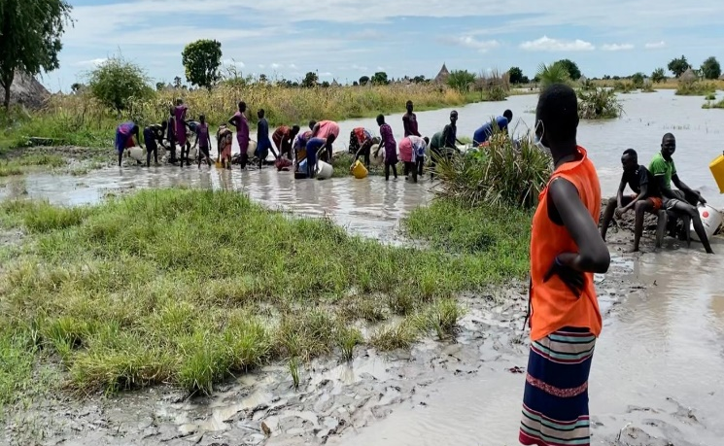
Chapter 1: Context Developments
Residents repairing dykes. Photo Credit @OCHA
Since the signing of the R-ARCSS in 2018, certain milestones of the peace process have been achieved, namely the creation of the Revitalized Transitional Government of National Unity (R-TGoNU) in 2020 and the appointment of the Reconstituted National Assembly in 2021. However, critical tasks are yet to be completed, such as the establishment of the unified forces and the formulation of a permanent constitution. Moreover, certain armed opposition groups remain outside of the peace process and threaten stability. There has been a resurgence of intercommunal violence in several parts of the country. Governance institutions and the rule of law remain weak resulting in human rights violations and abuses, including conflict-related gender-based violence and sexual exploitation. Road ambushes persist, with a number of humanitarian workers killed.
Humanitarian needs have increased, with 8.9 million people in need of assistance at the end of the reporting period. This has largely been driven and compounded by the intersection of a range of shocks and ongoing crises, including: sub-national conflict, localized violence and an upsurge in destruction or looting of property; widespread flooding; pest infestations; COVID-19 pandemic; deepening food insecurity; inflation and high food prices; lack of basic services.
Of those in need of assistance, two million are IDPs (1.4 million require urgent support) and 328,000 are refugees and asylum seekers. In addition, there are 6 million vulnerable host community/non-displaced people, including older persons or persons with disabilities.
South Sudan holds sub-Saharan Africa’s third largest oil reserves at an estimated 3.5 billion barrels. The resource
represents approximately 95% of exports and is a fundamental driver of Government revenue, which if optimised could enable significant gains across the SDGs. However, this lack of economic diversification leaves the country over-exposed to fluctuations in global markets and vulnerable to regional instability. The recent coup d’état in Sudan and ongoing conflict in Ethiopia are of particular concern, potentially undermining the economic gains achieved across the region. At the domestic level, the over-reliance on oil coupled with a weak PFM system has enabled pervasive corruption. (South Sudan was ranked as the most corrupt country in the world in 2021.) In return for a USD 334 million loan from the IMF, the government has agreed a series of related macroeconomic policies and reforms, under the coordination of the newly established PFM Secretariat in the Ministry of Finance and Planning, which could help unlock significant resources for sustainable development in the country.
During 2021, the Revised National Development Strategy (R-NDS) was drafted. The risk-informed approach arguably represents the best prospect to date for the country’s journey towards the 2030 Agenda. It acknowledges the obstacles to sustainable development in country, seeking to prepare for the multiple threats and complex risks posed by the current context within both planning and implementation processes. The Strategy determines to build the resilience of the population, whilst consolidating peace, reducing the humanitarian footprint, stabilizing the economy and enabling a return to sustainable development.

Slide 7
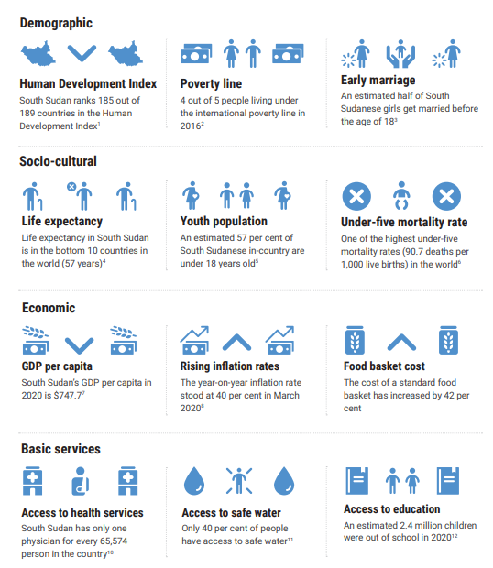
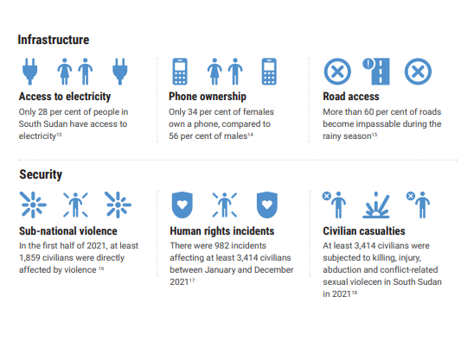
Sources: 1. Human Development Report 2020, UNDP 2. Informing Durable Solutions for Internal Displacement in Nigeria, Somalia, South Sudan, and Sudan, World Bank 3. UNICEF press release https://uni.cf/3sldk4q 4. World Bank. 2020. South Sudan Economic Update, February 2020 : Poverty and Vulnerability in a Fragile Environment 5 World Bank. 2020. South Sudan Economic Update, February 2020 : Poverty and Vulnerability in a Fragile Environment 6. United Nations Inter-agency Group for Child Mortality Estimation, 2019. Sources: 7. GDP Per Capita, South Sudan Overview, World Bank, October 2020 8. Rising inflation rates, United Nations South Sudan, COVID-19 Socio- Economic Response Plan 9. Food basket cost, WFP 10. Access to health service, WHO 11. Access to safe water, WASH Briefing Note, UNICEF, July-September 202112. Access to education, UNESCO Institute for Statistics, 2019 13. Access to electricity, World Bank, Sustainable Energy for All ( SE4ALL ) database 14. Phone ownership, Mobile Money Research in South Sudan, World Bank, June 2020 15. Road access, South Sudan: Logistics Cluster - Concept of Operations, August 2020 16. Sub-national violence, UNMISS, Quarterly brief on violence affecting civilians, June 2021 17. Human rights incidents UNMISS, Quarterly brief on violence affecting civilians, June 2021 18. UNMISS Human Rights Division, Annual Brief on Violence Affecting Civilians, February 2022.

Slide 8
Chapter 2: UN Development System Support to National Priorities through the Cooperation Framework
Political Fragmentation & Lack of Social Cohesion
Persistence of Conflict and Localised Violence
Recurrent Shocks (Natural Disasters, Pandemics, Epidemics)
Chronic Economic Under-development
Lack of Basic Services
Priority I. Building Peace & Strengthening Governance
Priority III. Strengthening Social Services
Priority IV. Empowering Women & Youth
Priority II. Improving Food Security & Recovering Local Economies
Institutional Capacity Development
Policy Support inc. Normative Agenda
Mainstream Resilience
South Sudan Key Challenges
UNCF Priorities & Strategic Approach
2.1. Overview of UNCF Results
In 2021, the UNCT extended the 2019-2021 UNCF by one year, with the endorsement of Government and regional DCO. The extension was timed to coincide with the completion of the National Development Strategy review, thereby allowing for the national priorities therein to inform the formulation of the forthcoming UNSDCF (2023-2025).
As part of the UNCF extension, the UNCT agreed on the following priority areas which formed Joint Programmes for 2021/2022 implementation:
Essential Health Services
Education for Children and Young People
Agricultural Production, Food and Nutrition Security
Governance and Access to Justice
Preparing for a National Census
Area-based Programming for Returnees/ IDPs
Disaster Risk Reduction (Especially Floods)
Peacebuilding & Democratic Transition
National Development Strategy Review
Gender-Based violence
Across the UNCF, including the joint programmes—as part of our commitment to Leave No-One Behind (LNOB), the Human Rights-Based Approach (HRBA) plus Gender Equality and Women’s Empowerment (GEWE)—our support prioritises the most vulnerable. In South Sudan, this means targeting women and youth (over 70% of the country’s population are below 30 years with the majority unemployed). It also means focusing on those most in need of humanitarian assistance and most likely to be marginalized as various drivers of vulnerability intersect. This includes children, IDPs, refugees, persons with disabilities and those living in flood-affected areas.

Slide 9
In 2021, building on the strong foundations established in the first two years of UNCF implementation, significant contributions were made by the UN across the H-D-P nexus. Substantial support was delivered to implement (some of) the peacebuilding measures agreed under the R-ARCSS, meet the basic needs of the population and enable medium to longer-term processes for the achievement of national sustainable development priorities.
As stated in the previous section, certain key provisions of the peace agreement were implemented, namely the full constitution of the R-TGoNU, with appointment of State Governors and Transitional National Legislative Assembly in 2021. PFM reforms have also been enabled with UN support, including revision of key legislation such as the PFM Act and National Audit Chamber Act. Understanding of human rights, human rights law and humanitarian law has been enhanced among core government, security and justice sector personnel which should contribute to the establishment of the rule of law in the country. Access to justice has been expanded through the use of mobile courts, provision of legal aid services and set-up of Police Community Relations Committees. Case management services for children have significantly improved through a range of interventions including: development of multidisciplinary training module based on the Child Act 2008 for critical national and state Justice for Children actors; capacity support to state social workers around the provision of the Child Act 2008 and broader children’s rights; the dissemination of positive messages around children’s rights to 36,557 people (18,598 girls, 15,349 boys, 1,235 women, 1,375 men). Further, 561 children and youth (191 girls) benefitted from case management services including mental health and psychosocial support, referrals, family tracing and reunification.
Conditions for the recovery of local economies were also improved (albeit marginally given the significant flooding experienced in 2021 and the increase in local conflicts affecting agricultural production), with the release of 9,105,488 m² of land through survey and clearance of explosive ordnances. This enabled safe movement and by extension the resumption of livelihood activities for refugees, IDPs and host communities. Cash transfers (both conditional and unconditional) not only helped 47,358 vulnerable households to meet their basic needs—in terms of food, education and health services—but also facilitated the purchase of assets for longer-term resilience and avoidance of negative coping mechanisms. Household and community assets—from agricultural land and access roads to multi-purpose water infrastructure and irrigation plots—were created, benefitting more than 710,600 individuals. Almost 1 million households received support for agricultural activities, whilst almost 25,000 benefitted from vocational and business development skills training. In addition, disaster risk preparedness and response were enhanced alongside climate change adaptation measures through a range of multi-sectoral interventions from the national to the community level, including seasonal livelihoods programming.
“The goal of the R-NDS is to consolidate peace, reduce humanitarian footprint, stabilize the economy, and return to sustainable development”
Revised-National Development Strategy of
South Sudan 2021
Since the beginning of the UNCF, access to basic healthcare, nutrition, education and WASH services in South Sudan has been delivered to the most vulnerable populations, in particular women and children, despite significant challenges. In 2021, the following key health results were secured: 8,541,744 outpatients were seen in health facilities across the country; 1,596,369 curative consultations (860,655 female and 735,714 male) were conducted, of which 46% were children under five year(423,814 girls and 398,113 boys); 400,760 infants received, DPT3/Penta vaccination. Access to and take-up of quality, gender responsive, youth-friendly sexual and reproductive health services was also expanded, with over 4 million people (including the most vulnerable populations adolescents and young people, persons with disabilities, sex workers and persons living with HIV) reached with related services. The health supply management system was upgraded, with e-LMIS software and quarterly stock monitoring for all health facilities instituted, resulting in 72% of facilities not reporting stock-outs in the last three months. Improvements in HIV prevalence and medical treatment of People Living with HIV (PLHIV) were also seen with the estimated adult (15-49 years) HIV prevalence decreasing to 2.1% from 2.3% in 2020 and the number of PLHIV on treatment increased to 27%.
Under the WASH sector, almost 100,000 (29,658 IDPs; 70,000 vulnerable host communities) gained access to piped water following the completion of the Juba piped water scheme, and 600,000 people connected to the South Sudan Urban Water Corporation network in Juba, Wau and Bor were able to access safe, treated water.
UNCF Output Target Delivery 2021

Slide 10
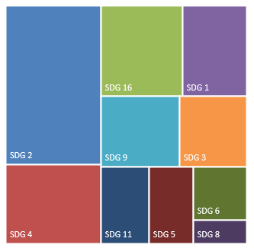
25,891 adolescents and youth alongside 20,745 adult stakeholders plus provision of non-formal education to 4,503 youth (1,691 female; 2,812 male) from pastoralist communities.
Under UNCF Priority IV, women’s and youth’s participation in and leadership of decision-making processes has been promoted, including the creation of the permanent constitution. Progress of South Sudan’s 2015-2020 National Action Plan (SSNAP) on UNSCR 1325 (Women, Peace, and Security) has been reviewed, under the leadership of the Ministry of Gender Child and Social Welfare (MGCSW). In addition, the Africa Youth Charter was ratified, Youth Development Policy enacted plus the Youth and Youth Enterprise Bills tabled. The United Nations Security Council Resolution around Youth, Peace and Security (UNSDCR 2250) has also been domesticated.
In terms of protecting women and youth from violence, key steps include: analysis of South Sudan laws at national and state level for discrimination towards women and girls to inform advocacy for repeal or amendment of relevant legislation; trainings of justice and security sector institutions on issues related to SGBV survival, case management and referral; establishment of Women Empowerment Centres and Women Peace Huts as safe spaces for women and girls where GBV and harmful social norms are confidentially discussed; 99,524 people (27,338 girls; 22,501 boys; 28,982 women; 20,703 men) supported with GBV risk mitigation, prevention, or response interventions and referrals to other specialized services.
Resource Distribution by SDG (Top 10)
WASH and Nutrition interventions were integrated across health and education sectors to improve service delivery and take-up. For example, gender separate latrines were constructed in over 20 health centres and schools whilst school feeding programmes reached 526,511pupils (46% girls; 54% boys). Lifesaving nutrition services were also delivered to over two million children and infant and young child feeding (IYCF) practices were improved through counselling to 2,144,873 mothers and caregivers of children aged 0-23 months. Moreover, Blanket Supplementary Feeding Programmes helped fill nutrient gaps for Pregnant and Lactating Women (PLW) and under <5 children whilst advocacy continued to ensure nutrition remained a national priority for both government and donors. The proportion of children 6-59 months suffering from acute malnutrition (AM) decreased from 16.2 per cent in 2019 to 11.3% in 2021. Other interventions in the education sector secured a reduction of pupil-to-textbook ratio from 8-to-1 to 3-to-1, delivery of Comprehensive Sexuality Education to
COVID-19: Examples of the UN Programme & Policy Response
COVID-19 Strategic Preparedness and Response Plan as well as related guidelines reviewed, updated, and implemented.
Handwashing devices installed and operated in key hotspot areas. Boreholes also rehabilitated or drilled in over 192 schools to mitigate spread of the virus.
Technical support to government and implementing partners provided to ensure continuous, safe delivery of nutrition services to children and women within the context of COVID-19.
Health workers trained and communities sensitised for the safe provision of immunization services.
5,180 vulnerable households provided with vouchers for hygiene materials (soap and hand washing buckets), and an additional 1,106 extremely vulnerable households received unconditional cash assistance to cover their basic needs.
Continuity of learning through the COVID-19 pandemic ensured for 1.5 million (40% females) learners at primary, secondary and TVET levels, through utilisation of radio, online and distance learning.
School Reopening Technical Working Group led by Ministry of General Education and Instruction supported to ensure smooth and safe reopening of schools after protracted closure.

Slide 11
2.2. Priorities Under the UNCF: Key Results Secured with UN Support
PRIORITY I: BUILDING PEACE & STRENGTHENING GOVERNANCE
Provisions of the Peace Agreement Implemented
The R-TGoNU fully constituted with appointment of State Governors and Transitional National Legislative Assembly in 2021. Governors have been brought together to address critical issues related to the peace process, in particular security concerns.
PFM reforms enabled, including revision of key legislation such as the PFM Act and National Audit Chamber Act, plus the reactivation of the PFM Donor working group. Such interventions – alongside the support provided to oversight institutions including the Anti-Corruption Commission and Law Review Commission - should unlock much-needed resources for the country’s sustainable development agenda.
Human Rights Better Protected
Understanding of human rights significantly improved through a range of trainings and awareness-raising initiatives of key personnel. These included over 12,000 (37% women) political leaders, Government officials, members of the Armed Forces, the Police and the National Security Service, representatives of the Prison service, the judiciary, the Human Rights Commission plus human rights defenders, civil society activists, community leaders and youth. Also, 5,823 (1,644 women) officials from the military police and military intelligence, the Presidential Republican Guards (Tiger Battalion), the National Security Service and the South Sudan National Police Service (SSNPS). The latter were trained in international human rights law and humanitarian law by personnel drawn from the South Sudan People’s Defence Forces (SSPDF).
Access To Justice Enhanced
Mobile courts deployed to hard-to-reach locations, facilitating a case disposal rate of 86% up from 57.6% in the previous year and enhancing public confidence and trust in the judicial system.
2,158 vulnerable people (72% female) benefitted from legal aid services delivered in Justice and Confidence Centres (JCCs).
52 Police Community Relations Committees (PCRCs) established in consultation with the police, traditional authorities and communities in five key locations where crime is particularly prevalent. As part of the set-up, 478 PCRC members (208 females) were trained on their roles and responsibilities in community policing.
Multiple mechanisms, including legal frameworks and policies, developed to address conflict-related sexual violence and protect victims, survivors, witnesses and other judicial actors. Both national government and parties to the conflict committed to eliminate such practices and bring perpetrators to justice. Relatedly, dialogues supported among conflict-affected women, civil society, justice institutions, and law enforcement agencies focusing upon transitional justice and the participation of conflict-affected women.
414 prisoners profited from vocational skills training across three central prisons. Each are now equipped with livelihood skills for their rehabilitation and successful reintegration following release.
Justice For Children Improved
Case management services for children significantly improved through a range of interventions including: development of a multidisciplinary training module based on the Child Act 2008 (with both facilitators guide and participants handbook) for critical national and state Justice for Children actors and capacity support to state social workers around the provision of the Child Act 2008 and broader children’s rights.
561 children and youth (191 girls) benefitted from case management services including mental health and psychosocial support, referrals, family tracing and reunification.
Awareness of children’s rights enhanced, with approximately 36,557 people reached with positive messages (18,598 girls, 15,349 boys, 1,235 women, 1,375 men).
Key Challenges
Delays in R-ARCSS implementation, including creation of the Unified Forces and completion of Disarmament, Demobilisation and Reintegration processes
Weak Governance institutions in particular those related to security, justice and the rule of law
Increase in sub-national and localized violence involving community-based militias, including abductions and conflict-related sexual violence plus deliberate destruction of land and property
Target Delivery 2021 (Output)

Slide 12
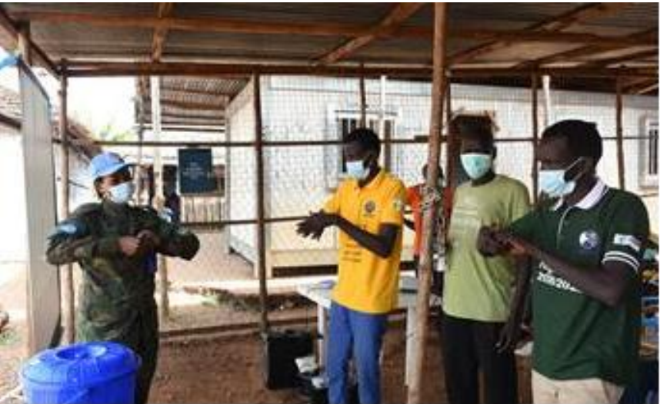
UNMISS engagement team training community members on handwashing. Photo Credit: UNMISS
All-Female UNMISS Engagement Team Wins Hearts & Minds Across South Sudan
As peacekeepers, when we’re patrolling, we meet everybody—women, men, children, the elderly, the disabled,” says Sub Lieutenant Agnes Arthur from Ghana. “Conflict affects men and women differently. In South Sudan, which is still recovering from the devastating effects of civil war, women and girls are more comfortable speaking about their problems, their hopes, their ambitions to other women.” As the commander of the UNMISS Female Engagement Team stationed in Bentiu, Agnes speaks from experience. Agnes and the 85 Ghanaian peacekeepers under her command have a busy schedule: they protect women collecting firewood from nearby villages, conduct free medical camps and even provide life-saving medical assistance to host communities, when the need arises. “When the COVID-19 pandemic took hold across South Sudan, we knew we had to help keep the people we serve safe, healthy and informed of preventive measures,” she states. This led the dynamic all-female team peacekeepers to organize a sanitation drive at the Bentiu State Hospital. “Every day is unpredictable,” says Lieutenant Winny Batamuriza from Rwanda. “We do myriad tasks in support of the UNMISS mandate—last year, for example, we helped people in Yapa village rebuild their homes following intercommunal violence and gave medical aid to two young women who were injured badly while attempting to cross a river during the rainy season.” United Nations peace operations have increasingly used the capabilities of women peacekeepers, especially among its military component, to engage entire populations. “It’s simple,” states Lieutenant-General Shailesh Tinaikar, UNMISS Force Commander. “Women constitute 50 per cent of any society and we as peacekeeping missions need to reflect the societies we serve. Engaging populations is key if we are to build durable peace across South Sudan and our Female Engagement Teams help us reach a segment of the local population and obtain situational awareness that men may not be able to as effectively.”

Slide 13
PRIORITY TWO: IMPROVING FOOD SECURITY & RECOVERING LOCAL ECONOMIES
Conditions for Recovery of Local Economies Improved
Safe movement and livelihoods for refugees, IDPs and host communities enabled through the release of 9,105,488 m² of land through survey and clearance of explosive ordnances. Interventions included explosive ordnance risk education for communities plus assessments of 12 medical units, 51 natural water sources, 122 agricultural areas and 24 markets to support resumption of livelihood activities across the country.
Access to Basic Goods and Services Enabled
Access to basic goods and services significantly improved through cash transfers to 47,358 households. Of these 19,588 households were enrolled under the cash for work aspect; 27,770 households benefitted from direct income support. 20,554 of the targeted households were trained in WASH, financial literacy and early childhood development and nutrition. Beneficiaries used the cash to purchase food, education and health services. 93% of households indicated an improvement in living standards as a result of the cash transfer, 79% no longer needed to sell assets to purchase food or meet other basic needs, 77% were enabled to purchase assets, essential goods and services which they ordinarily could not afford. Anecdotal evidence also indicates a reduction in negative coping mechanisms.
Protection from the COVID-19 virus afforded to 5,180 households through the delivery of vouchers for hygiene materials (soap and hand washing buckets), with an additional 1,106 extremely vulnerable households receiving unconditional cash assistance to cover their basic needs.
Assets for Vulnerable Communities Created
Household and community assets created under the Food Assistance for Assets programme, benefitting more than 710,600 (252,623 received cash transfers; 457,977 received food assistance). In 2021, 44,552 hectares of crop land, 522 hectares of vegetable gardens, 478km of access roads, 160km dykes, 72 water and fish were created. In addition, a number of seed stores, solar-powered boreholes, multipurpose water infrastructure and irrigations plots were constructed/drilled across key locations.
Livelihoods & Resilience of Vulnerable Populations Enhanced
30,000 (18,000 female; 12,000 male) vulnerable smallholder farmers trained in livelihood development, post-harvest management and market access. Resilience platforms and
steering committees also established, responsible for planning and setting policies to improve the enabling environment and promote community development. An additional 990,000 households were supported with various forms of agricultural assistance depending on preference, under the Emergency Livelihoods and Resilience Programme. Animals including livestock belonging to 225,000 households were vaccinated (6,383,104) and treated (1,973,333).
Community flood preparedness and response enhanced through development of hazard maps, local climate-sensitive agricultural practices and implementation of disaster risk reduction strategies by community and local disaster risk reduction committees. Seasonal livelihoods programming also expanded across the target areas, through use of community-based participatory planning.
595 women (some from female-headed households, some pregnant or lactating mothers, and some survivors of SGBV) trained and supported with start-up kits to pursue livelihood opportunities.
Access to finance improved for 1,950 IDPs and members of host communities (1,647 females; 303 males) through establishment of 53 Village Savings and Lending Associations.
21,592 beneficiaries trained on financial literacy and 332 youth (225 female) trained across a range of vocational skills using the competency-based curriculum developed by Ministry of General Education and Instruction.
The Partnership for Recovery & Resilience (PfRR) at national and level strengthened, with UN contributions to the Steering Committee, Task Force, Technical Engagement Group and Joint Analysis, Monitoring and Measurement Group.
Key Challenges
Widespread flooding and COVID-19 pandemic restrictions disrupted livelihood activities, including food production and trading opportunities.
High prevalence of localised violence and road ambushes negatively impacted on movement of goods and people.
Continued depreciation of the South Sudan Pound against the Dollar resulted in increased prices of basic commodities and reduced purchasing power for vulnerable households
Target Delivery 2021 (Output)

Slide 14
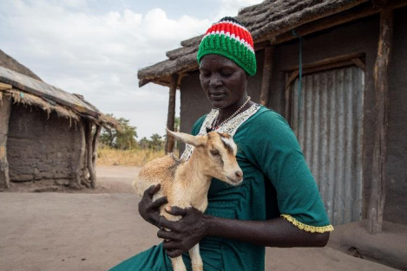
Khana Carrying One of Her Goats, her newly discovered source of livelihood, Photo Credit: FAO
Allowing Communities to Dream Big
The goats began swarming around Khana Akuang Malual before she had even put the plastic tub of salt on the ground. There were 20 of them – her most valuable possessions – jostling one another to get a lick. Just three years ago, she had none.
Amidst delays implementing South Sudan’s 2018 peace agreement, civilian-on-civilian violence driven by access to resources intensified in Lakes State, where Khana lives. Her husband had to limit his movements to keep safe, so the burden of running the family farm fell to Khana. She was struggling to produce enough to feed her seven children even one meal a day. Meals were grain heavy and light in vitamins.
With support through the UN’s Sustainable Agriculture for Economic Resiliency (SAFER) project, Khana has increased her farm’s production by 150 percent. This has been achieved by diversifying her produce and applying good agronomic practices. The SAFER method of bringing farmers together has fostered peer-to-peer learning and collaboration that has also contributed to her increased production. Business management and finance courses, alongside basic literacy and numeracy support, inspired Khana to invest the money she earned. The goats provide milk – enough for her children plus extra to sell – and meat for special occasions. Moreover, their manure is excellent fertilizer for her farming. Now the family eats twice per day instead of once and their meals are full of fresh vegetables. “My children, my husband and I are the healthiest we’ve ever been,” she says. “We don’t get sick nearly as often as we did when we ate only grains and milk.” she proclaims. Khana has big dreams. “Within the next five to ten years, I want to be farming for business – not consumption,” she says. The SAFER project is implemented by FAO thanks to funding from the United States Agency for International Development.
Notes:
WFP,,,,, UNOPS,,

Slide 15
PRIORITY THREE: STRENGTHENING SOCIAL SERVICES
Access to Integrated, Quality Health Care, including HIV Improved
8,541,744 outpatients (new and repeat visits) seen in health facilities across the country. Sustained community sensitization on availability of services, training of health workers in triage and safe provision of care plus the roll out of standard treatment guidelines contributed to this achievement.
Provision of high-quality child health services enabled through the scale-up of Integrated Management of Common Childhood Illness (IMNCI) and the roll out of the Boma Health Initiative (BHI) at community level. 1,596,369 curative consultations (860,655 female and 735,714 male) were conducted, of which 46% were children under five years (423,814 girls and 398,113 boys).
400,760 infants received DPT3/Penta vaccination following training of health workers in immunization in practice, safe provision of immunization services as well as robust microplanning and community sensitization of safe access within the context of Covid-19.
Preparedness for Health-Related Shocks strengthened in relation to Ebola, Cholera and COVID-19. The Ebola Viral Disease (EVD) Readiness Plan was updated, implemented and tested following an assessment in the final quarter of 2021. The Cholera contingency plan was also reviewed updated and implemented within the context of country-wide flooding. In addition, the COVID-19 strategic preparedness and response plan as well as guidelines were reviewed, updated and implemented.
Access to and take-up of quality, gender responsive, youth-friendly sexual and reproductive health services was improved with over 4 million people (including the most vulnerable populations, adolescents and young people, persons with disabilities, sex workers and persons living with HIV) reached with related services.
Obstetric provision was enhanced with 30 medical doctors and 15 clinical officers strengthening their skills in emergency obstetrics and surgery, 132 midwives and nurses graduating and being deployed to health facilities alongside 36 national UNV midwives.
The Ministry of Health supported with procurement and last mile delivery of over USD 1.8m worth of reproductive health commodities and supplies, including dignity kits.
Supply management system upgraded, with e-LMIS software utilised for inventory management at the Central Medical Stores and quarterly stock monitoring for all health facilities. 72% of facilities did not report stock-outs in the last three months. Dissemination of the essential
medicines list and standard treatment guidelines enhanced rational use of medicines. Facilities also benefited from regional redistribution of over-stocked supplies in some facilities, thus avoiding stock-outs within the region. This is a result of regular coordination and monitoring of pharmaceuticals by partners.
Improvements in HIV prevalence and medical treatment of PLHIV secured. Estimated adult (15-49 years) HIV prevalence decreased to 2.1% from 2.3% in 2020. (The data continues to indicate higher HIV prevalence among key populations, mainly female sex workers.) The number of PLHIV on treatment has increased, with preliminary data showing that PLHIV on treatment is likely to exceed 47,000 at the end of 2021, representing national coverage of 27%. The UN continues to undertake HIV campaigns, provide integrated HIV/TB services and supplementary food distribution to PLHIV.
Sustainable WASH services Delivered to Vulnerable, Underserved and Emergency Affected Populations
Juba piped water scheme completed with daily capacity of 4,650m3/d to jointly serve the IDP population (29,658) and vulnerable host communities (70,000).
Safe water (through treatment support) piped to an estimated 600,000 people connected to the South Sudan Urban Water Corporation network
Daily water service provision ensured for IDPs living in Bentiu, Wau and Malakal through operation and maintenance of large-scale water distribution and surface water treatment (SWAT) systems.
WASH interventions integrated across health and education sectors to improve service delivery and take-up. Construction of gender separate latrines commenced in 20 health centres and schools. Boreholes were drilled in 87 schools.
National Covid-19 Preparedness & Response Plan supported by the installation and operation of handwashing devices in key hotspot areas. In addition, boreholes were rehabilitated or drilled in over 192 schools to mitigate spread.
Nutrition of Vulnerable Women and Children Enhanced
526,511pupils (46% girls, 54% boys) benefited from school feeding programmes, receiving either daily hot meals at school or take-home rations at the end of the month upon attending 80 percent of school days. Complementary activities included establishment of school gardens and provision of deworming
Target Delivery 2021 (Output)

Slide 16
medication. Pupils under the school feeding programme also received education, psychosocial services, health and nutrition services.
Essential nutrition supplies required for treatment of children with severe wasting provided, ensuring over two million children received lifesaving nutrition services. 93% of under five children with MAM (93.8% girls; 92.6% boys) and 76.3% of under five children with SAM treated (71% girls; 81.7% boys).
Infant and young child feeding (IYCF) practices improved through counselling to 2,144,873 mothers and caregivers of children (0-23 months) across 1,213 nutrition sites and in communities.
Additional support for improved nutrition of vulnerable populations included: a Blanket Supplementary Feeding Programme to fill nutrient gap for Pregnant and Lactating Women (PLW) and under <5 children; advocacy to maintain nutrition as a national priority targeting both government and donors; provision of technical support to government and implementing partners to ensure continuous, safe delivery of services to children and women within the context of COVID-19.
Education and TVET Opportunities Provided
Continuity of learning through the COVID-19 pandemic ensured for 1.5 million (40% females) learners at primary, secondary and TVET levels, through utilisation of radio, online and distance learning.
School Reopening Technical Working Group (SRTWG) led by Ministry of General Education and Instruction (MoGEI) supported to ensure smooth and safe reopening of schools after protracted closure during COVID -19 pandemic.
“Back to Learning” campaign undertaken in partnership with the MOGEI to encourage school-going age children to enroll or re-enroll. As part of this initiative, textbooks were procured and distributed for 1.1 million school children, improving the pupil-to-textbook ratio from 8-to-1 to 3-to-1.
A total of 25,891 adolescents and youth (learners) in 50 secondary schools and 3 universities provided with Comprehensive Sexuality Education and SRH/HIV information. In addition, 20 Master trainers were supported and 230 facilitators equipped with the necessary knowledge and skills to roll out CSE programmes across 6 locations for out-of-school young people. 20,745 (8,324 female; 12,412 male) chiefs, women leaders, youth leaders, religious leaders, police officers, prison wardens, community leaders, young people and journalists were reached with advocacy and awareness messages on CSE.
Non-formal education services and TVET training provided to 4,503 (1,691 female; 2,812 male) learners in pastoralist communities.
Key Challenges
Lack of basic infrastructure (57% of health facilities not operational in conflict-affected areas; 30% of schools damaged, destroyed, occupied or closed) and insufficient numbers of trained professionals (proportion of births attended by skilled health personnel was 19% in 2020; only 21% of teachers are trained.)
Direct and indirect costs of services, low population density, language barriers, inadequate access to accurate information/education, recurrent health crises alongside harmful practices such as gender-based violence, discrimination & child marriage contribute to low performance across the social sector.
Unprecedented levels of flooding negatively impacted access to safe water services already compromised by poor maintenance (of limited facilities), fragmented and weak government institutions, limited funding and COVID-19 pandemic.

Slide 17
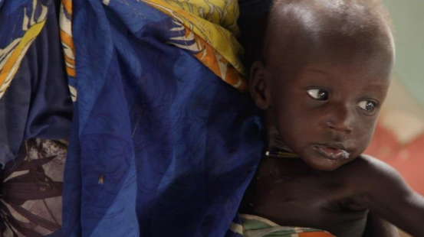
Kanyet and His Child at the Primary Health Care and Stabilisation Centre in Pibor, Photo Credit: WHO
Lifesaving Care for Under-5s with Severe Acute Malnutrition
A visibly anxious and exhausted 25-year-old Kanyet Modi walks into Pibor primary health care and stabilization centre in the morning hours, holding his seven-month son Nyaprilem Baal. He is vomiting and has fever and diarrhoea. Nyaprilem was screened and found to have severe acute malnutrition with medical complications at the outpatient therapeutic programme. “I brought my son to the health centre because he lost appetite and extremely lost weight,” said Kanyet. “I was going to lose my son if he was not brought for treatment”.
Pibor county along with many other areas of South Sudan has been severely affected with floods, resulting in displacement and destruction of livelihoods which in turn has led to food insecurity and an increase in acute malnutrition cases among children. Dr Olushayo Olu, the World Health Organization (WHO) Representative in South Sudan asserts “We are working with the Ministry of Health and partners to provide the much-needed healthcare to the [flood] affected population and prepare more so that South Sudan does not fall further. Thanks to the generous contribution of the South Sudan Humanitarian Fund (SSHF), the UN is taking every opportunity to ensure that children suffering from severe acute malnutrition with medical complications are reached on time with lifesaving health care services.”
Notes:
,,,, WFP, WHO,, UNMISS,

Slide 18
PRIORITY FOUR: EMPOWERING WOMEN & YOUTH
Gender Equality and Women’s Empowerment Advanced
Progress towards 35% representation of women in key decision-making structures made as a result of a range of initiatives related to advocacy and awareness-raising (although still short of the target). Amongst the key appointments include: one Vice President, 25.71% of the Cabinet; one Deputy Minister; one State Governor; 33.09% of parliamentary seats.
Effective and meaningful participation in the permanent constitution-making process by women representatives in key transitional institutions (including the NCAC) enabled through awareness-raising sessions on the gender provisions of the R-ARCSS and legislative review from a gender perspective.
Progress of South Sudan’s 2015-2020 National Action Plan (SSNAP) on UNSCR 1325 (Women, Peace, and Security) reviewed. The process was inclusive and participatory, involving 21 Ministries and Government Institutions, 2 CSOs, and 2 Academic Institutions under the leadership of the Ministry of Gender Child and Social Welfare (MGCSW)
South Sudan laws at national and state level mapped and analysed for discrimination towards women and girls. Findings have been used to inform advocacy campaigns for repeal or amendment of relevant legislation.
Justice and security sector institutions trained on issues related to gender sensitivity, SGBV survival safety, psychosocial health, incidence analysis and reporting, case management and referral. The institutions included: Ministry of Defence; South Sudan Defence Forces (SSDF); National Security Service; SSNPS; Prisons Service; Wildlife Service; Fire Brigade (Civil Defence Force).
Women Empowerment Centres and Women Peace Huts established in Aweil, Bor, and Akobo. The facilities offer safe spaces for women and girls where GBV and harmful social norms—such as early and child marriages, wife inheritance, property ownership, girl-child education, and revenge killings—are freely and confidentially discussed.
Community mobilization mechanisms for eliminating child marriage established. Approximately 99,524 people (27,338 girls; 22,501 boys; 28,982 women; 20,703 men) were reached with GBV risk mitigation, prevention or response interventions and referrals to other specialized services.
2,795 (958 girls; 24 boys; 1,789 women; 24 men) reached with direct services in Women and Girl Friendly spaces (WGFS) and 826 (166 girls; 6 boys; 633 women; 31 men) benefitted from skills-building courses on livelihoods and wellbeing.
Youth Empowerment and Participation Boosted
Africa Youth Charter ratified, Youth Development Policy enacted plus the Youth and Youth Enterprise Bills tabled.
The United Nations Security Council Resolution around Youth, Peace and Security (UNSDCR 2250) domesticated. 190 policy makers and young people were brought together acknowledging the Youth’s important, positive role in the maintenance and promotion of international peace and security.
Institutional capacity to address youth related concerns strengthened across government through a range of products and capacity development initiatives. A Youth Participation Guide, Youth Mainstreaming Guide and Toolkit were produced. Youth Ministries at national and state level (eight) were capacitated to provide leadership in youth programming. Meanwhile, Ministries of Health, Gender and Finance as well as the National Bureau of Statistics benefitted from targeted support to better integrate youth’s concerns in their work.
Collaboration improved across a range of issues of significance to South Sudan’s youth through the creation and operationalisation of multi-sectoral youth coordination mechanisms.
Key Challenges
Persistence of harmful traditional practices and discriminatory social norms
Limited access to quality education, decent employment opportunities and productive assets, particularly for women, youth and other vulnerable groups
Under-representation of women and youth in decision-making bodies
Target Delivery 2021 (Output)

Slide 19
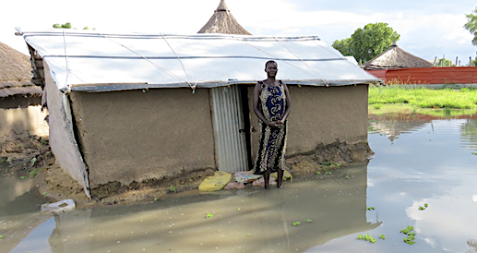
© IMA World Health South Sudan
Renewed Hope in a Crisis
Severe flooding affected hundreds of thousands in South Sudan during the 2021 rainy season. Bor resident, Kedia, 49, had barely recovered from the floods of the previous year when her family’s home was once again flooded. “We have nowhere to go to escape the flood, so we stayed in the flooded house. We don’t know where to get food. The situation is very difficult for me,” said Kedia. Her husband is a retired soldier and has no regular source of income to feed their six children.
Kedia found a glimmer of hope when one of the female chiefs in her village told her about the Women and Girl-Friendly Space (WGFS) being managed by Interchurch Medical Assistance (IMA) through UNFPA, with funding support from ECHO. “When I visited the WGFS, the staff and other women warmly welcomed me and listened as I told them about myself and my family,” Kedia said. “I am happy to have another family at the WGFS. I am excited about the training on tailoring that I joined. I know my life will change when I finish this course because I will have my own business.”
The UN supports the WGFS to provide women and girls affected by humanitarian crises with a safe entry point for services and information about their health and well-being, especially for those at risk of gender-based violence during displacement. There are currently 13 WGFS in South Sudan, benefitting more than 250,000 individuals per year. ECHO, Japan, Norway and Denmark are the principal donors.

Slide 20
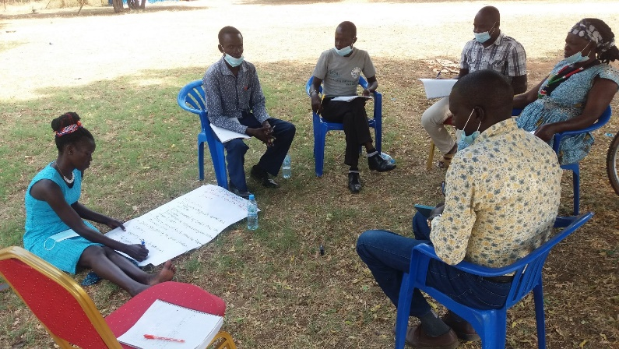
2.3. Support to Partnerships and Financing the 2030 Agenda
During 2021, the UNCT increased its engagement with government, development and local implementing partners, strengthening coordination to help meet immediate needs, advance progress on national priorities and the Sustainable Development Goals (SDGs).
Resources have been mobilized through a range of channels, such as agencies’ core funds, bilateral arrangements with donors in-country and Multi-Partner Trust Funds.
The UN’s partnership with the Government has continued to mature since the formation of the R-TGoNU in February 2020. The DSRSG/RC/HC and UN Heads of Agencies have engaged the political leadership at Vice President and ministerial level on concerns related to the peace process and broader humanitarian, recovery and development issues. For development planning and operations, the UN has worked closely with the Ministry of Finance and Planning (MoFP)—in particular for the review of the NDS and the formulation of the UNSDCF 2023-2025—whilst UN agencies have partnered with a range of sectoral ministries, departments and agencies (MDAs) and local authorities for particular thematic/sectoral interventions. The UN’s partnership with local authorities and local implementing partners has been particularly critical to ensure hard-to-reach communities and vulnerable groups have benefitted from both humanitarian and development support.
There are challenges with regard to data on development financing, partially because donors currently do not share their funding data with government. However, as part of the NDS review and on-going PFM reforms, the MoFP is undertaking a Development Finance Assessment. This will inform an Integrated National Financing Framework with a costed plan which includes financing strategies and funding sources. Development partners are providing capacity support to the Aid Coordination Unit at MoFP to strengthen development coordination. Meanwhile, the UN is working with Development Partners alongside relevant MDAs in the recently revived Sector Working Groups (SWGs). These have been created to inform sectoral level planning, budgeting and coordination, ensuring full alignment with and improved delivery for the achievement of national priorities.
In addition, at sub-national level, the UN is participating in the Partnership for Recovery and Resilience (PfRR). This brings together donors, UN agencies and NGOs to reduce vulnerability and improve the resilience of people, communities and institutions across four key locations: Yambio; Torit; Wau; Aweil. The Partnership serves as a useful entry point for area-based programming and implementation of the nexus approach (see Priority II for summary of key results).
It is anticipated that the consultations held with donors and other stakeholders during the drafting of the CCA and UNSDCF formulation will stimulate more interest in the work of the UN, help determine realistic resource mobilisation targets and shape UNCT’s efforts to leverage various financial streams for SDG financing
Through the UN/NGO Partnership Working Group, the UNCT has deepened its partnership with the NGO forum, which is critical for humanitarian delivery in South Sudan. Going forward, the UN will also scale up support to Civil Society Organizations (CSOs), given their crucial role in the implementation of the peace agreement and broader objectives related to good governance, the rule of law and access to justice. Further, it will continue to work with the burgeoning private sector to enable the creation of a strong, resilient economy and human development. For its own operations in 2021, the UNCT strengthened the Contractor Information Management System (CIMS) Database to mitigate the risk of doing business with entities that do not abide by the highest ethical standards.
IA4R Townhall in Torit, PfRR (ALSF)
Key Contributions:
USD 47.6 million for collaborations with World Bank
USD 38 million from the UN’s Central Emergency Response Fund (CERF)
USD 25 million (active projects) from Peacebuilding Fund
USD 12 million under the Reconciliation, Stabilization, and Resilience Trust Fund (RSRTF)
USD 7 Million from the Global Partnership for Education (GPE)
USD 1.2 million from the Government of Japan
USD 1 million from the SDG Fund for Finance
USD 200,000 for collaborations with the African Development Bank

Slide 21
2.4. Results of the UN Working More And Better Together:
UN Coherence, Effectiveness and Efficiency
The use of joint programmes under the current UNCF and the commitment to the triple nexus approach (as evidenced by the collective outcomes around food security and GBV) will be sustained into the next Framework. Following strategic prioritization for the UNSDCF 2023-2025, discussions are underway for a new set of collective outcomes and joint programmes which best respond to both the immediate needs and longer-term ambitions of the country going forward.
In addition, the UNCT remains fully aligned to the Code of Cooperation. This brings the priorities of UNCT members together under the UNCF as the strategic anchor for repositioning the UN Development System in country. This is realised in a number of ways:
The UNCF represents UNCT consensus on the priorities it wishes to support, with agencies reporting on their programmatic contributions regularly through the joint planning and reporting system (UN INFO) and results-oriented reports shared annually with Government and partners.
The UNCT is used as a forum for close working relations and strong mutual accountability between Heads of Agencies and the DSRSG/RC/HC.
The UNCT participates in regular joint consultations with government for greater national ownership and accelerated progress towards the SDGs.
The UNCT supports stronger coordination of CSO/NGO programming through the UN/NGO Partnerships Working Group.
UNCT invests significant financial and human resources in joint programming under the UNCF and makes annual contributions to joint coordination bodies, such as the Programme Management Team, Operations Management Team (OMT), UN Communication Group, Monitoring and Evaluation Group plus Preventions of Sexual Abuse and Exploitation Group, Contractor Information System etc
The UNCT jointly supports data generation. During the reporting period, the UN enabled the National Bureau of Statistics to complete South Sudan’s first SDG Data Landscape diagnostics for better understanding of the national data ecosystem and current capacities. This is the first step to ensuring that policy-making and programming across all sectors can be evidence-based and more appropriately targeted to reach the furthest behind first.
Business Operations
Following the transition of the 2018-2022 Business Operations Strategy (BOS) to the online BOS 2.0 platform, substantial efficiencies have been secured. In 2021, the OMT implemented and operationalized agreed common services in Finance, Human Resources, Information Communication Technology, Procurement, Administration and Logistics allowing for the calculation of cost avoidance and monitoring of quality for the first time. So far, the UNCT has managed to avoid costs worth US$8.18 million for the period 2019-2021 against a projection of US$ 15.95 million for 2019-2024 period; and the quality of those services have shown modest improvement. The cost avoidance has mainly been realized by reduction in recurrent costs and staff time in the processes of acquiring goods and services either through the joint LTAs and or piggybacking on existing LTAs/ Agreements.
In parallel, the UN is exploring possibilities for scale-up of existing UN Common premises (to include more participating agencies) and opportunities for new co-locations. This is in pursuit of the Secretary General’s goal to realise efficiencies through the increase of UN common premises.

Slide 22
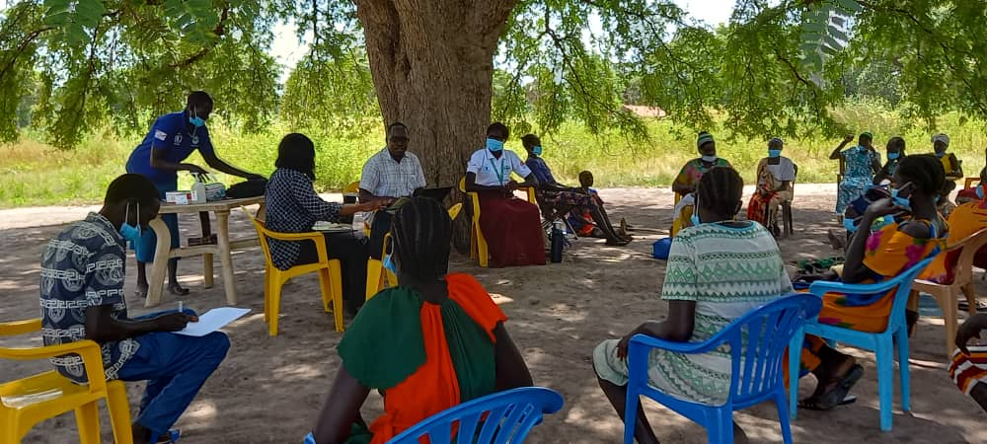
2.5. Evaluations and Lessons Learned
The independent evaluation of the UNCF was undertaken in the last quarter of 2021 by a team of international and national consultants. The evaluation sought to assess the contribution made by the UN to national development results, identify factors that (positively or negatively) affected results achieved, measure progress on collaboration/linkages between programmes and operations as well actors across the H-D-P nexus plus provide actionable recommendations for improving the UNCT's contribution for incorporation into the UNSDCF 2023-2025.
The evaluation drew upon: primary data collected in Juba, Wau, Bor, Yambio, and Rumbek; semi-structured interviews with 225 key informants from UN agencies, Government, Implementing Partners, Community Leaders and Donors; 24 focus group discussions (involving women, youth and men with a 63% female and 37% male split); 4 joint programme case studies, one for each UNCF priority area.
Recommendations
Continue alignment of the Cooperation framework to national planning frameworks and strategies whilst paying particular attention to emerging issues related to climate change, environment, gender, youth, and the private sector.
Further integrate the Nexus Approach in programming and optimize the collective contribution by the UN system, including through technical support from regional bodies and NRAs
Deepen the New Way of Working and strengthen coherence between UNCF and other key frameworks like PfRR, HRP, Mission Strategic vision, while extending collaboration to new development partners.
Strengthen and improve the availability of routine, comprehensive, disaggregated data and data systems, including the development of a national framework for monitoring and reporting on SDGs.
Explore opportunities for better collaboration and coordination with IFIs and donors to promote the development of the private sector.
Develop a coherent UNCT funding strategy to streamline resource mobilization for UNCF implementation.
Consider striking a balance in the allocation of the South Sudan Reconciliation, Stabilization, and Resilience Trust Fund (RSRTF) across the H-D-P window.
Establish a Joint Steering Committee of Government, UN and Donors to provide direction and strategic oversight of the Cooperation Framework, whilst raising awareness of the UNCF among national and state level stakeholders.
Review the existing UNCT technical architecture/working groups to respond to changes in context and needs (including strengthening coordination and collaboration between UN structures in Juba and state/field level structures for increased impact).
Strengthen the alignment and coordination of the UNCF Results Groups, Sector Working Groups, humanitarian clusters to avoid duplication and ensure effective utilization of resources.

Slide 23
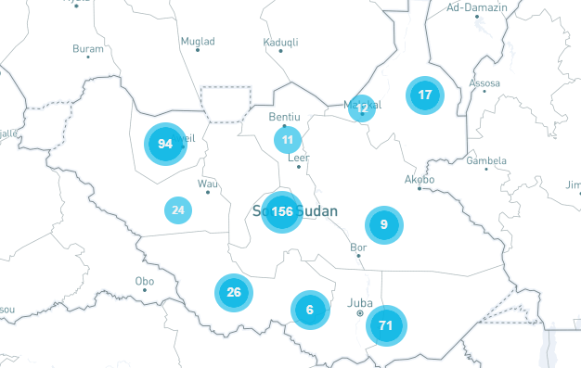
2.6. Financial Overview and Resource Mobilization
In 2021, UNCT’s financial delivery stood at 91%, with an expenditure of USD 264,359,599 against a budget of USD 290,154,177. This represents a 30% increase in delivery over the previous year and provides an average of 81% delivery over the lifetime of the UNCF to date.
As in previous years, the ‘average’ delivery rate belies significant differences in performance across the four priority areas, as funds were reallocated to meet emerging needs or impacted by challenges in the enabling environment. Specifically, in response to a number of severe
UNCF Financial Delivery 2019-2021
shocks experienced during the year–flooding, COVID-19 and invasion of locusts—the majority of funding went into provision of social services and then improving food security. Priority III and Priority II consequently show a delivery rate of 180% and 64% respectively.
Conversely, the two priority areas most closely related to the R-ARCSS provisions, namely Priorities I and IV, reveal significant under-performance, given the delays in implementation of key peace agreement provisions referenced above. Further, activities geared towards empowering women and youth that necessitated physical engagement of communities and individuals were affected by Covid-19 restrictions---leading to cancellation or postponement of activities in some instances. ‘Building Peace and Strengthening Governance’ therefore expended 17% of planned budget for the year whilst ‘Empowerment of Women and Youth’ expended 23%.
Where We Work (# of Sub-Outputs)

Slide 24
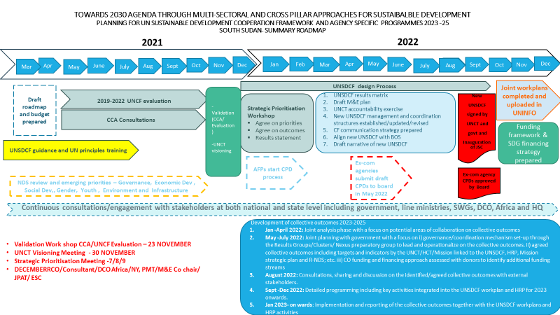
Chapter 3: UNCT Key Focus for 2022
The UNCT plans to use the extension of the UNCF by one year to build on the successes and lessons learnt to date, expanding and adjusting the scope of programming in country. The operational context for 2022 is likely to be shaped by the following concerns:
Implementation of the R-ARCSS should enter the next stage, with intensified dialogue regarding the preparations for the elections and permanent constitution-making process anticipated.
Continued fluidity in population movement, including new and secondary displacements related to localized and sub-national conflicts and floods, with women and children most affected. Also, returnees from both internal displacements and from outside the country will continue to face increasing needs in the areas of food security and agriculture, social services, protection, housing, land and property.
Increasing humanitarian needs. Over 8.9M people are currently in need of humanitarian assistance (Humanitarian Needs Overview 2022)
The high number of youth not in employment, education or training. 70% of the country’s population is below 30 years and majority are unemployed, with their basic social needs unmet.
The strain placed by the COVID-19 pandemic on an already weak and under-resourced health care system and the negative socio-economic impact of COVD-19 on health, education, GBV and women’s rights will persist. This will require multiple stakeholders to collaborate across a number of joint solutions.
Going into 2022, the UNCT will also complete work started at the tail end of 2021 for the formulation of the UNSDCF 2023-2025. At time of writing, the process is on-track with multiple stakeholders contributing their time and expertise to the design.
UNSDCF 2023-2025 Roadmap

Slide 25

2021 UN COUNTRY ANNUAL RESULTS REPORT
SOUTH SUDAN
https://southsudan.un.org/
UNSouthSudan (@UN_SouthSudan) / Twitter

